Slide 1

4 Bit Computational Code Conversion Calculator

Slide 2
4 Bit Computational Code Conversion Calculator
Himanshu verma
Acharya Narendra Dev College , University Of Delhi
Guide – Dr. Monika Bhattacharya, Prof. Anju Agrawal Dr. Ravneet Kaur
Department of Electronics Science , Acharya Narendra Dev College, University of Delhi, New Delhi, India

Slide 3
Introduction
This research project focuses on developing a 4-bit computational code conversion calculator. The primary objective of our project is to create, develop, and design a 4-bit computational code conversion calculator capable of computing, displaying, and representing conversions in other number systems such as BCD (Binary Coded Decimal), Gray code, Decimal, Hexadecimal, and Octal for 4-bit inputs (ranging from 0 to 15).

Slide 4
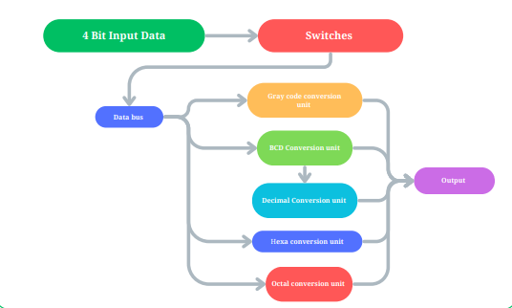
Working principle of 4 Bit Computational Code Conversion Calculator
The project basically works on the principle of conversion in the digital Electronics.
By switching the 4-bit data inputs, we will be able to represent and display equivalent codes in other number systems based on the binary inputs provided for conversion.

Slide 5
Applications
It can be used in advance computations when come to conversion in other number system.
It can used for scientKific research as we are living in the world of quantum computers
It can be used as a educational tool for better understanding of digital electronics and practical implementation in the context of experiential learning.

Slide 6
Advantages
By using this circuit design we will be able convert conversion in other all conversion by a single 4 bit inputs.
In this circuit we design a modular design through which every conversion unit can be function independently to occur convesions of other number system so it can detached and attached in accordance to which conversion we are needed.

Slide 7
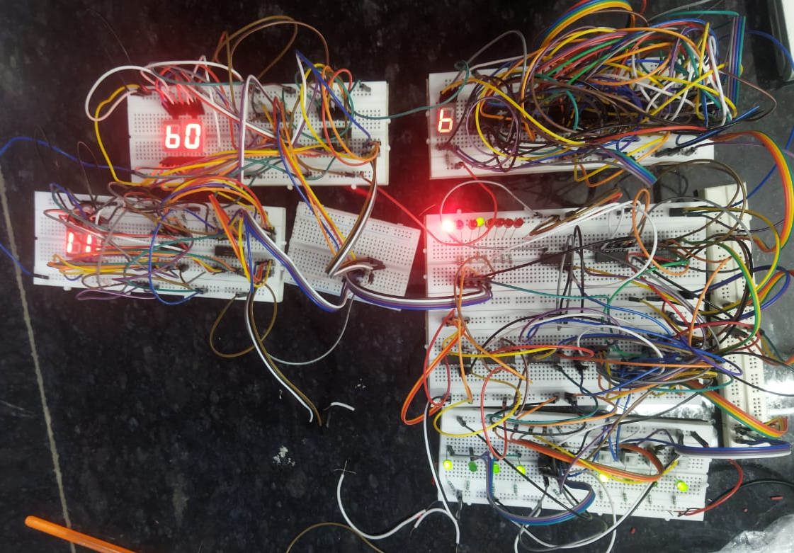
INNOVATION
We are trying to make a conversion system which is capable of compute , show, reperent conversion in other number system by switching single 4 bit data line
The calculator incorporates five different conversion units, each dedicated to a specific code conversion. These conversion units can also function independently, can be detached and operated to carry out specific conversion values as single conversion unit as well.

Slide 8
Acknowledgement
We would like to extend our heartfelt appreciation and profound gratitude to our esteemed mentors, Dr. Ravneet Kaur and Dr. Monika Bhattacharya, and Prof. Anju Agarwal for their unwavering support and invaluable guidance throughout our journey.
A special note of thanks to Dr. Amit Garg and all the faculty members of my department whose exemplary mentorship, diligent monitoring, and constant encouragement have been instrumental in the successful completion of our project.
We also express our sincere thanks to the dedicated support staff members whose assistance played a pivotal role in making our project a resounding success. Our heartfelt thanks to our friends(Naman ,Manish ,Abdul ,Dilsher and Farman) for helping us with the project.
Our deepest gratitude goes to our esteemed Principal Dr. Ravi Toteja, for providing us with the invaluable opportunity to embark on this meaningful project. Their blessings and unwavering support will undoubtedly propel us further in the journey of life. Lastly, a big thanks to all for the invaluable contributions to this research project.

Slide 9
THANK YOU

